Slide 1
The Cool Code Consortium
7-6-2017
Notes:
Use this for Pro Audio Segments

Slide 2
Stuff
High Level vs. Low Level
Cool News
Quick VHDL Example
Web Development
Next Week

Slide 3
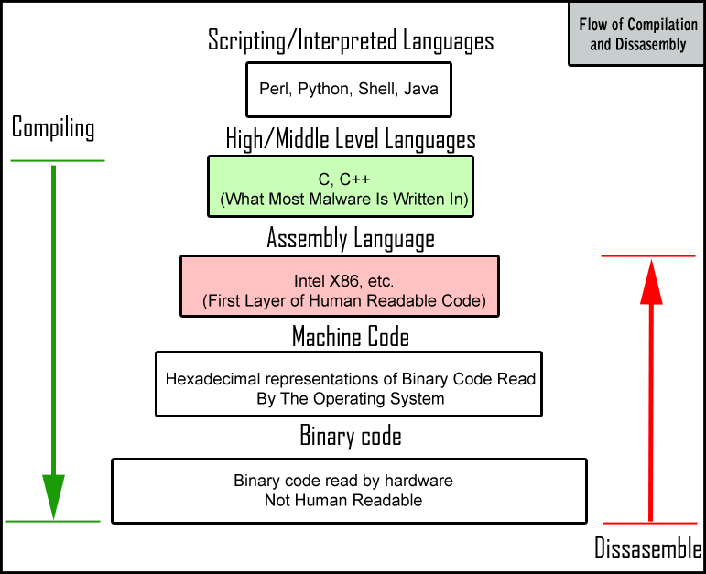

Slide 4
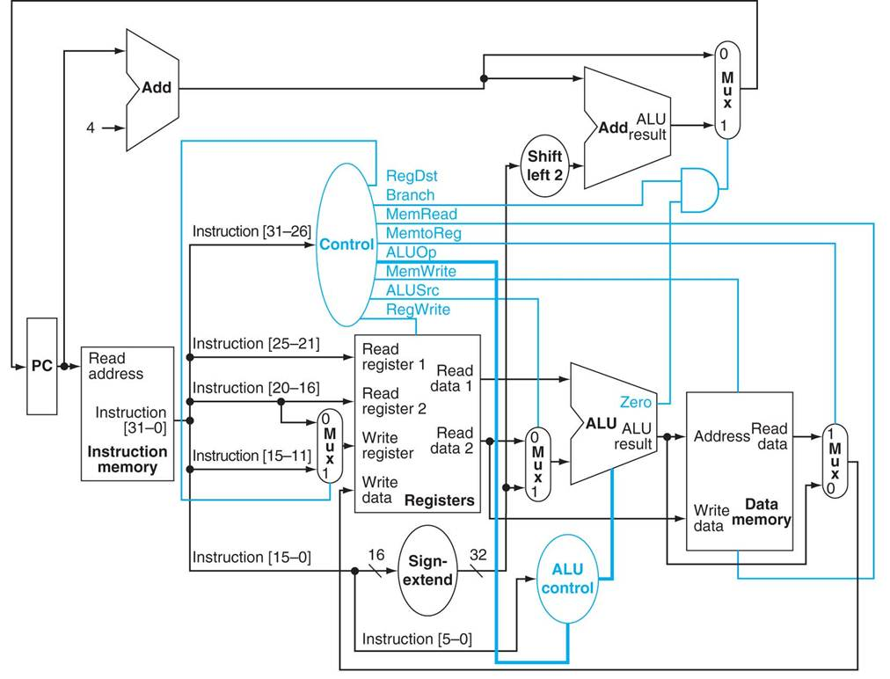

Slide 5
Cool News
http://www.technewsworld.com/story/Google-Launches-Go-To-Job-Aggregation-Site-84626.html
https://hbr.org/2017/06/male-and-female-entrepreneurs-get-asked-different-questions-by-vcs-and-it-affects-how-much-funding-they-get
https://techcrunch.com/2017/07/04/apple-said-to-be-exploring-face-scanning-technology-for-the-iphone/
http://spectrum.ieee.org/automaton/robotics/diy/anki-code-lab-brings-sophisticated-graphical-programming-to-cozmo-robot

Slide 6
Web Development

